Slide 1
How to develop a research question
June 14, 2022 10am-12pm
Sandy Eckel, PhD
eckel@usc.edu
Associate Professor USC Division of Biostatistics

Slide 2
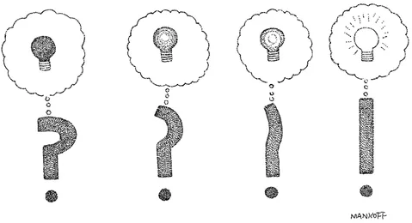
Objectives: develop research question
“The scientist is not a person who gives the right answers, he is one who asks the right questions.”
-Claude Levi-Strauss (French philosopher)
https://www.cartoonstock.com/search?type=images&keyword=ask+question&page=1

Slide 3
Objectives: develop research question
Review the scientific method
Crucial for hypothesis-driven statistical analysis
Important even for “discovery”/prediction analyses
Understand how to formulate a research question
What makes a well-specified research question?
What’s an appropriate/feasible study design to address the question?
Given the design, how do we interpret study results?
Be an informed consumer of scientific study results, and potentially plan your own!

Slide 4

The scientific method
Start with a scientific question
Form a hypothesis
Design an appropriate study
Make measurements/collect data
Analyze the data
Make conclusions
Communicate the results

Slide 5
Defining the research question, translating into a statistical question
What are the components of a good research question?
FINER and PICOT criteria (we’ll come to these later)
How do I translate my research question to a statistical question/hypothesis that I can test?
Be specific and quantitative!
Consider the study design(s) that can be used to answer the research question

Slide 6
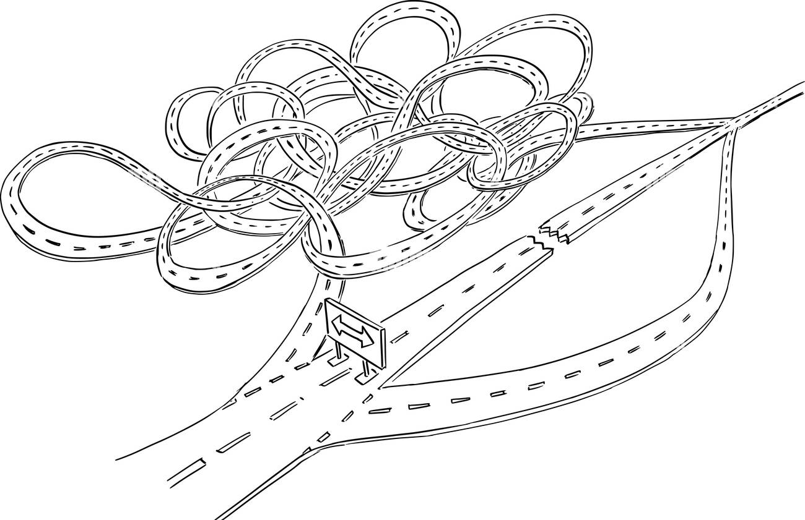
First, let’s discuss study designs

Slide 7
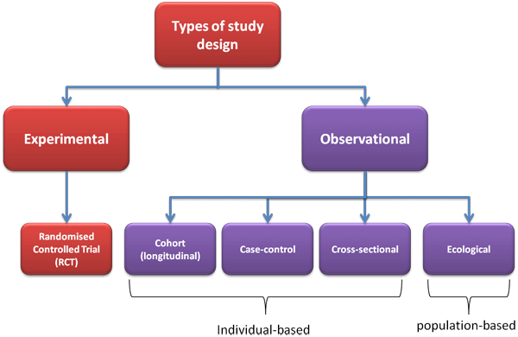
Major types of study designs

Slide 8
Consider these study designs in terms of the following broad research question
Broad research question:
Does air pollution impact health?
(Note: you will hear a lot about the Southern California Children’s Health Study (CHS)—led by USC investigators—in future class sessions, so here we consider other studies to provide perspective)

Slide 9
Observational studies - definition
Clinicaltrials.gov: a clinical study in which participants identified as belonging to study groups are assessed for biomedical or health outcomes. Participants may receive diagnostic, therapeutic, or other types of interventions, but the investigator does not assign participants to specific interventions (as in a clinical trial ). Exposures (interventions) are self-selected.
Associations between exposures/interventions and outcomes may be biased (confounded) by characteristics that differ between those that choose exposure vs. no exposure.

Slide 10
Observational: Cohort study
Select persons free of outcome, including persons with and without exposure. Follow forward in time to determine outcome. Does the proportion of persons with outcome (or rates of outcome) differ in persons with versus without the exposure? Exposed (E+): Children with asthma living in high pollution area Not exposed (E-): Children with asthma living in “clean” area
Outcome: Did they have a hospitalization for asthma? (Note: Define some period of time you will follow for outcomes; e.g., over a 12-month period) Compare: Hospitalization rates in exposed vs not exposed

Slide 11
Cohort study: pros/cons
Advantages:
Efficient (i.e., less sample size required) for “rare” exposures.
Temporal sequence between “exposure” and “outcome” is firmly established (by design).
Can study multiple outcomes (e.g., lung function growth, exacerbations, subsequent hospitalizations)
Less issue with subject selection biases (as we don’t know outcomes when selecting subjects)
Disadvantages:
Time and cost (often long follow-up of large numbers of persons)
Inefficient for:
rare outcomes (need a large sample to obtain sufficient outcomes) or
long latency period (between exposure and outcome)
Losses to follow-up may induce bias

Slide 12
Cohort study: example in literature
Cheng et al 2019. Association between ambient air pollution and breast cancer risk: The multiethnic cohort study https://www.ncbi.nlm.nih.gov/pubmed/30924138
Question: Is air pollution exposure associated with an increased risk of breast cancer?
Study design
57,589 females from the multiethnic cohort, residing mostly in LA County from recruitment through 2010
Outcome: breast cancer incidence (Cox model)
Exposure: time-varying air pollution assignments
Results: “Among women who lived within 500 m of major roads, significantly increased risks were observed with NOx (hazard ratio [HR] = 1.35, 95% confidence interval [95% CI]: 1.02–1.79)… Subgroup analyses suggested stronger associations of NOx and NO2 among African Americans and Japanese Americans.”

Slide 13
Observational: Case-control study
Select persons with (cases) and without (controls) outcome (O); determine their past exposure (E; i.e., BEFORE the outcome occurred). Does the proportion of persons who were exposed differ in cases and controls?
Cases: Children who developed asthma by age 15 Controls: 15-year-olds never diagnosed with asthma
Exposure: Early childhood air pollution exposures
Compare: Early childhood air pollution levels in cases vs controls.

Slide 14
Case-control study: pros/cons
Advantages:
Efficient (i.e., less sample size required) for “rare” diseases/outcomes.
Efficient when there is a long duration between “exposure” and “outcome” (no waiting to see if “exposed” persons develop disease or not)
Lower time and costs
Disadvantages:
Many possible “biases” (e.g., differential subject selection by case/control; differential recall of “exposure” by case/control)
Be very careful in design stage
Inefficient for rare exposures

Slide 15
Case-control: example in literature
Volk et al 2013. Traffic-Related Air Pollution, Particulate Matter, and Autism. https://www.ncbi.nlm.nih.gov/pubmed/23404082
Question: Is traffic-related pollution exposure related to the development of autism?
Study design:
Cases: 279 children with autism, from CA Dept. Dev. Services
Controls: 245 sampled from CA births (age, sex, area matched)
Mother’s address from birth certificate used to assign traffic exposures
Results: “Children with autism were more likely to live at residences that had the highest quartile of exposure to traffic-related air pollution, during gestation (AOR, 1.98 [95% CI, 1.20-3.31]) and during the first year of life (AOR, 3.10 [95% CI, 1.76-5.57]), compared with control children”

Slide 16
Observational: Cross-sectional study
Find population, measure outcome and exposure at the same time Are outcomes and exposure associated? Example: Sample children across southern California. In higher air pollution locations are there more kids with asthma?

Slide 17
Cross-sectional study: pros/cons
Advantages: Relatively quick and easy Can study rare diseases/outcomes or exposures (assuming you have access to a sufficient number) Is there something going on (any evidence of association) that can be followed up in more stringent design? Can often use existing data (medical records, etc.)
Disadvantages: No clue on temporal sequence between exposure and outcome (Were any biomarker differences apparent before the disease developed? In what time frame?)

Slide 18
Cross-sectional study: alternatives
Cohort Study Alternative: Obtain air pollution levels in group of children without asthma. Follow to xx (time) to ascertain development of asthma. Compare asthma rates by air pollution level.
Case-Control Alternative: Select samples of persons with asthma (cases) and without asthma (controls). Access historical data on air pollution levels in their hometowns. Compare pre-disease air pollution in cases and controls.

Slide 19
Cross-sectional: example in literature
Chen et al 2015. Ambient air pollution and neurotoxicity on brain structure: Evidence from women's health initiative memory study https://www.ncbi.nlm.nih.gov/pubmed/26075655
Question: Does air pollution exposure impact the brains of older women?
Study:
Population: 1,403 community-dwelling older women without dementia in Women’s Health Initiative Memory Study
Outcome: MRI scans of gray matter (GM) and white matter (WM) volume at ages 71-89 (2005-2006)
Exposure: cumulative PM2.5 exposure from 1999-2006 based on residential histories and air pollution monitoring network data
Results: “Older women with greater PM_{2.5} exposures had significantly smaller WM, but not GM, volumes, independent of geographical region, demographics, socioeconomic status, lifestyles, and clinical characteristics, including cardiovascular risk factors. For each interquartile increment (3.49μg/m³) of cumulative PM_{2.5} exposure, the average WM volume (WMV; 95% confidence interval) was 6.23cm³ (3.72–8.74) smaller in the total brain and 4.47cm³ (2.27–6.67) lower in the association areas, equivalent to 1 to 2 years of brain aging.”

Slide 20
Observational: Ecological study
Unit of observation is a population or community, rather than individuals
Compare community-level outcomes/exposures across a number of communities
Useful for monitoring population-level health
PROS:
Inexpensive
Cover a large population
Use readily available administrative data
CONS:
Subject to ecological fallacy: individual-level associations may not mirror group-level associations
Ascertainment of outcome/disease may vary by location

Slide 21
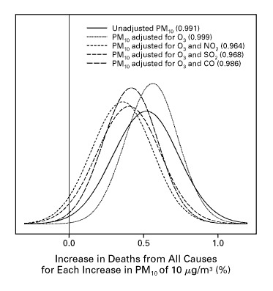
Ecological study: example in literature
Samet et al 2000. Fine particulate air pollution and mortality in 20 U.S. cities, 1987-1994. https://www.ncbi.nlm.nih.gov/pubmed/11114312
Question: Are city-level daily air pollution levels related to daily city-level mortality counts?
Design/population:
20 largest cities (counties) in the US
Collected: administrative daily, city-level data on: deaths, air pollution, meteorology
Results: “Every 10 μg/m³ increase in PM₁₀ was associated with 0.68 % increase in relative rate of death from cardiovascular/respiratory causes (95% CI: 0.20, 1.16)”
Notes:
Interesting: Bayesian analysis, so not really a CI but rather a posterior interval

Slide 22
Clinical trial - definition
Clinicaltrials.gov: A clinical study in which participants are assigned to receive one or more interventions (or no intervention) so that researchers can evaluate the effects of the interventions on biomedical or health-related outcomes. The assignments are determined by the study protocol. Participants may receive diagnostic, therapeutic, or other types of interventions. A cohort study where persons are “assigned” to exposures (interventions) and followed for ascertainment of outcomes. Clinical trials are not feasible when assignment to an exposure/intervention is not ethical.

Slide 23
Clinical trial - example
Sample: Postmenopausal women with recent hip fracture.
Intervention (exposure): Social support intervention vs. usual care
Comparator (not exposed): Usual care. Assign women to Intervention or Comparator. Outcome: Mortality in xx (time) following hip fracture.
Compare mortality (survival) rates in the intervention and comparator groups.

Slide 24
Clinical trial - example
Sample: Aged Alzheimer disease model mice
Intervention: High fat diet
Comparator (not exposed): Standard chow Assign mice to Intervention or Comparator Outcome: Alzheimer-like pathology after xx (time)
Compare pathology variables in the intervention and comparator groups

Slide 25
Assignment to intervention
Randomization Greatly reduces the possibility of systematic differences between study groups that might taint (confound) your conclusions regarding the efficacy of your experimental intervention. Key advantage over observational studies.
Blinded vs open-label (do participants/researchers know the intervention?) Knowing the intervention may affect how a participant responds, outcomes.

Slide 26
Trial designs
Parallel group: Each participant is assigned to one (and only one) of the trial interventions. Standard approach for most clinical trials
Crossover: Each participant receives both the experimental and comparator interventions, usually in randomized order, with a washout period between interventions Perfect matching – each participant acts as their own control – requires fewer subjects Disadvantages: Greater likelihood of dropout; must be a stable disease under study; only appropriate for interventions that wash-out and have short-term (not permanent) outcomes

Slide 27
e.g. Randomized controlled trial (RCT)
Jhun et al 2017. School environmental intervention to reduce particulate pollutant exposures for children with asthma https://www.ncbi.nlm.nih.gov/pubmed/27641483
Question: Does classroom-based air cleaner/filter intervention reduce particulate pollutants in classrooms of children with asthma? Does the lung function of these children improve with improved air?
Design (pilot study):
Population
18 classroom (9 control, 9 intervention)
25 kids with asthma (13 control, 12 intervention)
Intervention: Air filter in classrooms (randomized: filter or sham)
Measurements: air pollution in classrooms and lung function once before and twice after air filtration
Results:
“The intervention group had greater reductions in PM_{2.5} levels compared with the control group (2.3 μg/m³, 95% CI, −3.5 to −1.0; P = .003) [49% reduction]
The intervention group had a greater improvement in [peak expiratory flow]PEF compared with the control group (0.46 L/s, 95% CI, 0.09-0.83; P = .03) [16% improvement]”
Notes:
Also of interest:
inclusion/exclusion
duration of exposure/timing of measurements
Blinding of the randomization

Slide 28
…and we’re back to research qn’s!

Slide 29
Recall: Defining the research question, translating into a statistical question
What are the components of a good research question?
FINER and PICOT criteria (we’ll come to these NOW!)
How do I translate my research question to a statistical question/hypothesis that I can test?
Be specific and quantitative!
Consider the study design(s) that can be used to answer the research question

Slide 30
Research question → statistical question
Research Question
(general concepts)
Statistical Question
(statistical concepts)
Design a study and collect data to
test the statistical question
and answer the research question

Slide 31
Example: Research question → statistical question
Statistical Question(s):
Among persons age>70, do those who develop dementia have a higher proportion of systolic BP>120 than those who do not develop dementia?
Or…
Among persons age>70, is the incidence rate of dementia greater in those who have systolic BP>120 compared to those who did not?
Research Question:
Does higher systolic blood pressure (BP) increase dementia in the elderly?
1st statistical question: case-control study; Statistical concepts: Compare proportions (with systolic BP>120)
2nd statistical question: cohort study Statistical concepts: Compare incidence rates (developing dementia)
Other options: randomized trial?

Slide 32
The research question
States a relationship between two or more variables, phrasing in terms of some question.
Why is this research important? What is the research gap in our scientific understanding?
What is the past research in this area?
What areas need further exploration?
Can my study help fill in these gaps or lead to greater understanding?

Slide 33
Refining the research question
Identify the main concepts or keywords of your research question
Topic too broad? Add more concrete or specific terms to your question
Topic too narrow? Broaden content of terms

Slide 34
FINER criteria to develop the research question
F Feasible Adequate number of subjects and technical expertise Affordable in time and money Manageable in scope
I Interesting
N Novel Confirms, refutes or extends previous findings
E Ethical
R Relevant To scientific knowledge, clinical health and policy, future research
Hulley S, et al. Designing clinical research. Philadelphia (PA): Lippincott Williams and Wilkins; 2007.

Slide 35
PICOT criteria to develop the research question
P Population What specific population will you test the intervention in?
I Intervention (or Exposure) What is the intervention/exposure to be investigated?
C Comparison Group What is the main comparator to judge the effect of the exposure/intervention?
O Outcome What will you measure, improve, affect?
T Time Over what time period will outcome be assessed?
Sackett D, Richardson WS, Rosenburg W, Haynes RB. How to practice and teach evidence based medicine. 2nd ed. Churchill Livingstone; 1997.

Slide 36
Defining your Population: Population to Sample
Target population
Intended sample
Actual sample
Source population
Who you want to generalize to
Who you have access to
Who you plan to sample
Analysis sample
Notes:
Choosing a representative & feasible sample
Balancing science & practicality

Slide 37
Defining your population and sample
Target populations
What populations are relevant to the research question?
Demographics (e.g., age>70)
Clinical characteristics (not diagnosed with dementia)
Source populations
What population with the characteristics of the target population are available to you?
Geography (residents of Los Angeles county)
Temporal (e.g. recruitment period 1/1/2020 – 12/31/2023)
Availability affects generalizability and reproducibility
Intended sample
The part of the source population you will attempt to recruit; ideally representative of the source population
Prevalence of target characteristics

Slide 38
Operationalizing the general concepts in your research question
Research Question: Does elevated systolic blood pressure (BP) increase risk of dementia in elderly persons?
Population: Elderly persons Operationalize (who we will sample from): persons aged>70 without dementia (at baseline)
Intervention/exposure: Systolic BP level Operationalize: Average systolic BP>120 in prior 1 year
Comparator (and exposed) groups: Persons age>70 without dementia at baseline, without and with average systolic BP>120 in the prior year
Outcome: Dementia Operationalize: new diagnosis of dementia
Time: over 5 years of follow-up (time)

Slide 39
Research question→ Statistical question → Hypothesis
An objective framework for making scientific conclusions about a sample of data
Research question: What is to be described by a given research project and what relationships may be established? Does elevated systolic blood pressure (BP) increase risk of dementia in elderly persons?
Statistical question: Among persons aged>70 without dementia (population), does the 5-year (time) incidence rate of dementia (outcome: new dementia diagnosis) differ in those who did and did not have an average systolic BP>120 in the prior year (exposure/intervention and comparator)?
Hypothesis: A re-statement of the statistical question in a testable format, stating the relationship between measured variables – stated in “null” (H0: no relationship) and “alternative” (H1: the relationship we are interested in) formats
H0: In persons aged >70 without dementia at baseline, the 5-year incidence of dementia will be the same in those with average systolic BP in the prior year of >120 compared to those with average systolic BP in the prior year of ≤120
H1: In persons aged >70 without dementia at baseline, the 5-year incidence of dementia will be higher in those with average systolic BP in the prior year of >120 compared to those with average systolic BP in the prior year of ≤120

Slide 40
Recap: how to develop a research question
Review the scientific method
Understand how to formulate a research question
What makes a well-specified research question?
What’s an appropriate/feasible study design to address the question?
A broad research question can be addressed by many different study designs!

Slide 41

Activity time!

Slide 42
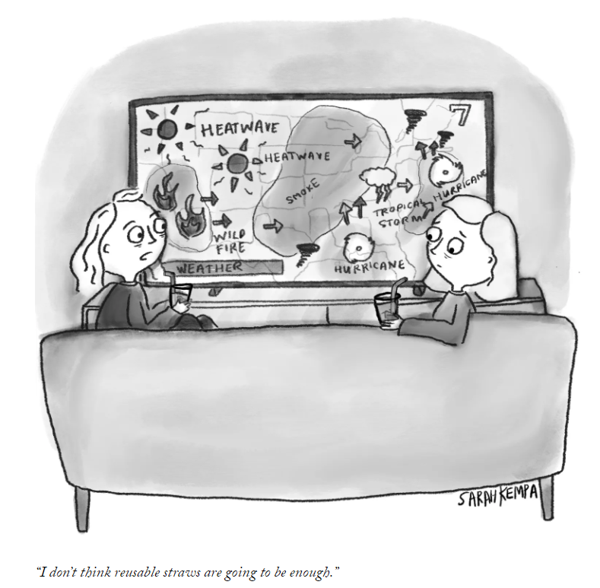
Background for discussion topic
I’ve spent my sabbatical learning/thinking about climate change and health
https://www.newyorker.com/cartoons/daily-cartoon/friday-september-17th-climate-straws

Slide 43
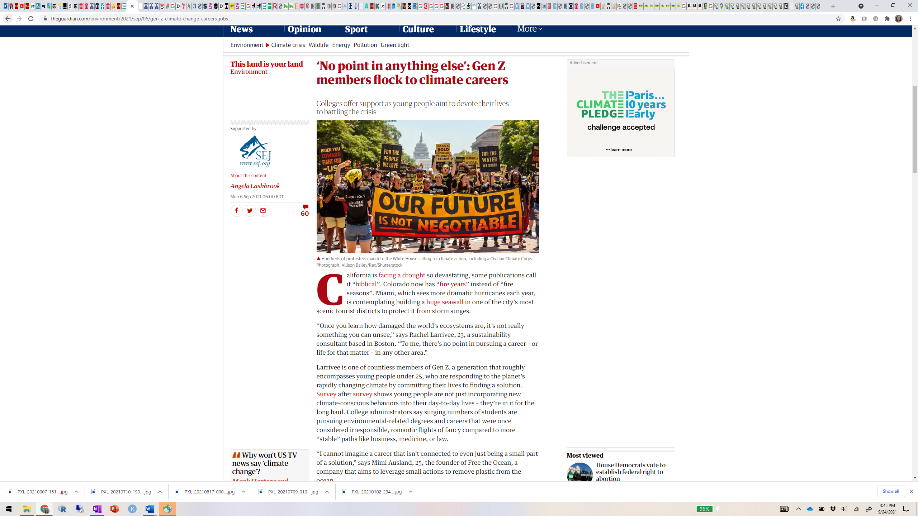

Slide 44



“Climate and sustainability is going to be the new computer science”
https://www.nytimes.com/2022/05/04/climate/john-doerr-stanford-climate.html

Slide 45
“Tackling climate change could be the greatest global health opportunity of the 21st century”
“Many mitigation and adaptation responses to climate change are “no-regret” options, which lead to direct reductions in the burden of ill-health, enhance community resilience, alleviate poverty, and address global inequity. Benefits are realised by ensuring that countries are unconstrained by climate change, enabling them to achieve better health and wellbeing for their populations. These strategies will also reduce pressures on national health budgets, delivering potentially large cost savings, and enable investments in stronger, more resilient health systems.”
Watts N, Adger WN, Agnolucci P, Blackstock J, Byass P, Cai W, Chaytor S, Colbourn T, Collins M, Cooper A, Cox PM. Health and climate change: policy responses to protect public health. The Lancet. 2015 Nov 7;386(10006):1861-914.

Slide 46
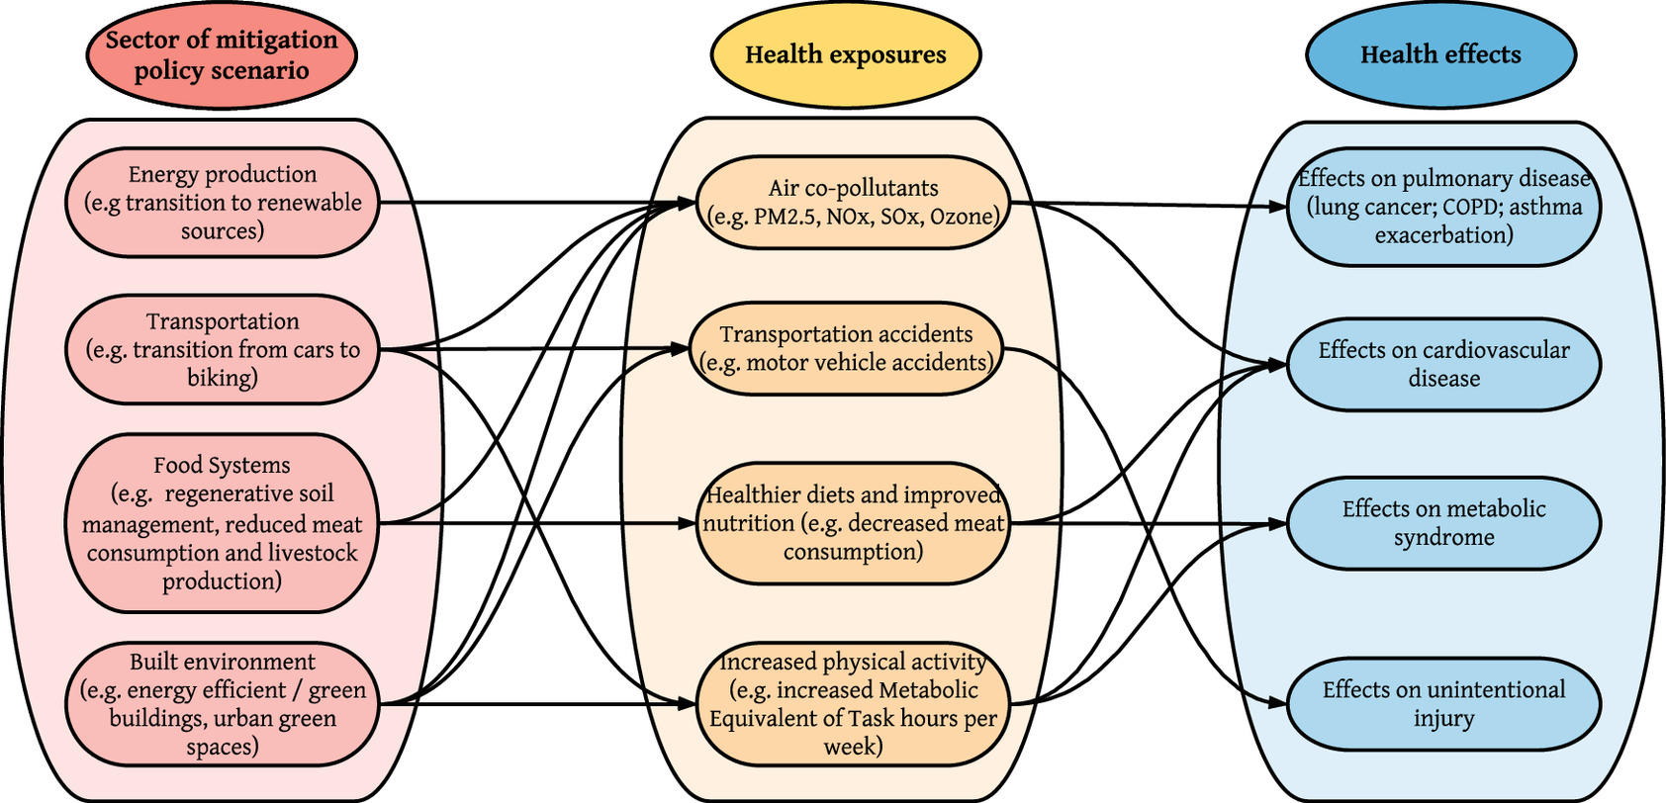
Idea of today’s activity: Design a study to describe health co-benefits climate change mitigation efforts
https://ehp.niehs.nih.gov/doi/10.1289/EHP6745

Slide 47
Plans for today’s activity
Theme: Research questions on health co-benefits of climate change mitigation efforts
PART I: Review a recent relevant study
Together we review basic features of the study
In 6 groups, you will:
Identify the PICOT criteria of this study’s research question & study design
Discuss strengths/weaknesses
Review together as a class
------------------------------
PART II: In 6 groups (of 3, since 18 students), you will:
Develop your own research question/hypothetical study (w/ assigned design) investigating health co-benefits of climate change mitigation efforts (ideas - see diagram previous slide)
Groups pair up to refine research question/study design
Each group presents their concept to the class – highlight strengths/weaknesses
Group 1: Randomized controlled trial
Group 2: Cohort
Group 3: Cross-sectional
Group 4: Case-control
Group 5: Ecological
Group 6: Randomized controlled trial

Slide 48

Meng YY, Yue D, Molitor J, Chen X, Su JG, Jerrett M. Reductions in NO2 and emergency room visits associated with California's goods movement policies: A quasi-experimental study. Environmental Research. 2022 Jun 3:113600. https://pubmed.ncbi.nlm.nih.gov/35660569/
Background:
SoCal has the 2 busiest container ports in the US
2006: emissions reduction plan (ERPPGM) for goods movements
While air quality improved, health impacts have not been directly studied
Notes:
Figure: https://www.maritime-executive.com/article/ports-of-long-beach-and-los-angeles-set-records-for-container-movement

Slide 49
PICOT criteria to develop the research question
P Population What specific population will you test the intervention in?
I Intervention (or Exposure) What is the intervention/exposure to be investigated?
C Comparison Group What is the main comparator to judge the effect of the exposure/intervention?
O Outcome What will you measure, improve, affect?
T Time Over what time period will outcome be assessed?
Sackett D, Richardson WS, Rosenburg W, Haynes RB. How to practice and teach evidence based medicine. 2nd ed. Churchill Livingstone; 1997.

Slide 50
Recap: how to develop a research question
Review the scientific method
Understand how to formulate a research question
What makes a well-specified research question?
What’s an appropriate/feasible study design to address the question?
A broad research question can be addressed by many different study designs!

Slide 51
Additional materials

Slide 52
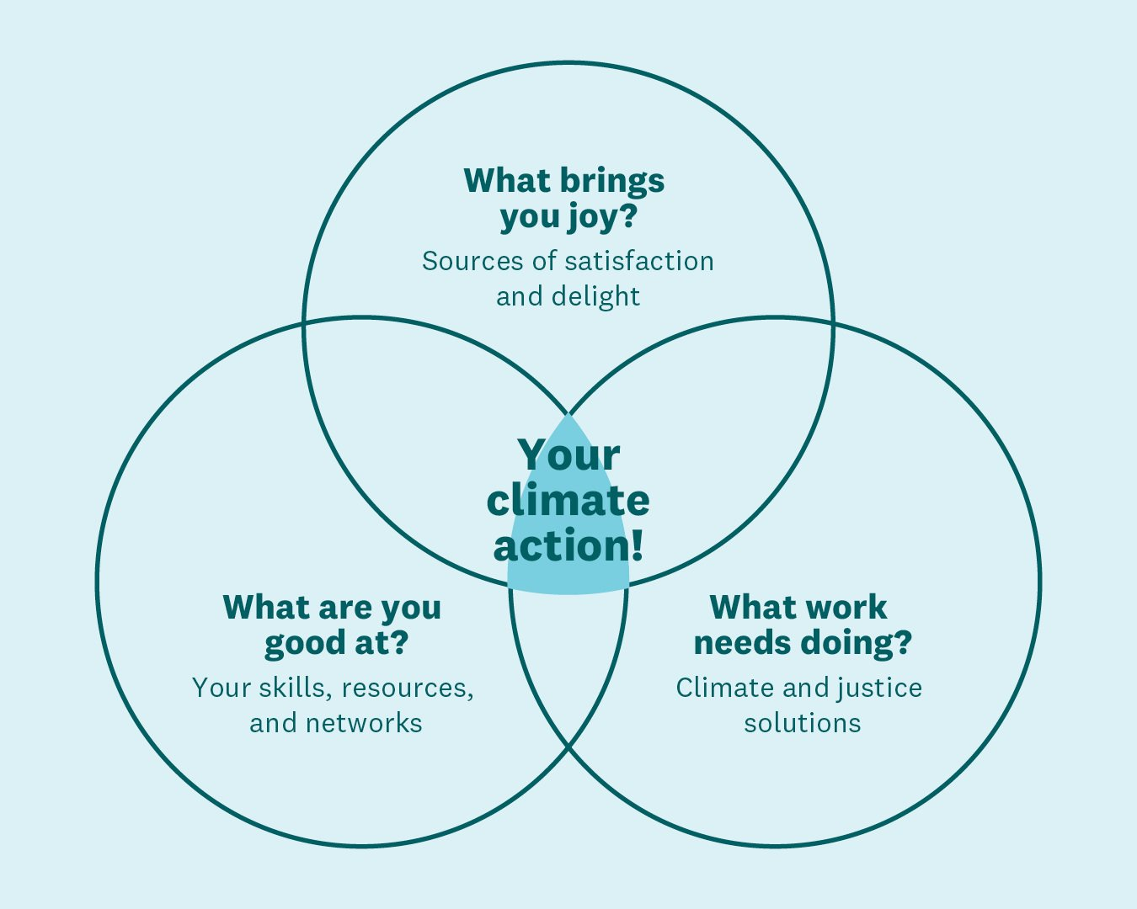

So what can I do?
https://www.ayanaelizabeth.com/climatevenn

Slide 53
Bonus: old activity
(from 2019)

Slide 54
Activity: design a study to investigate the “battle of the thermostat”
There have been claims that women like/need warmer office temperatures than men and office temperatures are generally set to standards from the 1970s based on men wearing suits
Temperature might impact performance and and other outcomes? e.g., SAT scores are 4% higher for high school boys than girls
You are interested in issues of gender equality in educational environments/workplace and want to study this issue further
PART I: In 6 groups, you will:
Develop a research question/hypothetical study (w/ assigned design) around this topic
Groups pair up to refine research question/study
Present to the class
------------------------------
PART II: Review a recent study (highly publicized in popular press) on this topic
Groups/all: Critique the published study, comparing it to your proposals
https://www.nytimes.com/2019/05/22/health/women-temperature-tests.html
https://news.usc.edu/157448/female-productivity-warmer-temperature/
https://reports.collegeboard.org/pdf/2018-total-group-sat-suite-assessments-annual-report.pdf

Slide 55
Groups (13 students → 5 groups of 2, 1 group of 3)
Group 1: Randomized controlled trial
Group 2: Cross-sectional
Group 3: Cohort
Group 4: Case-control
Group 5: Ecological
Group 6: Randomized controlled trial

Slide 56
Battle for the thermostat: Gender and the effect of temperature on cognitive performance
Chang, Tom Y., and Agne Kajackaite. "Battle for the thermostat: Gender and the effect of temperature on cognitive performance." PloS one 14.5 (2019): e0216362. https://journals.plos.org/plosone/article?id=10.1371/journal.pone.0216362
Randomized laboratory experiment
Population: 543 students in Berlin, Germany (randomly selected from convenience sample)
Exposure: room temperature varied from 61-91 F
Outcome: performance on 3 tests (math, verbal, cognitive reflection)
Time: tests took < 1 hour

Slide 57
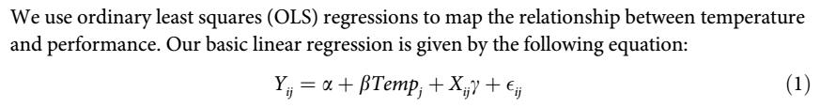
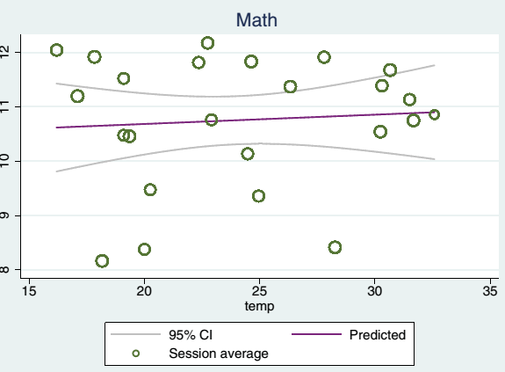
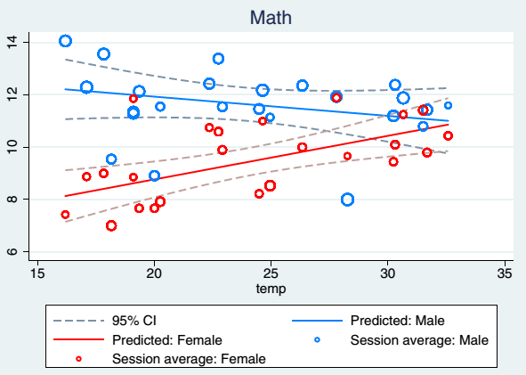
Battle for the thermostat: Gender and the effect of temperature on cognitive performance
Not accounting for sex
Accounting for sex

Slide 58
Critique this study
What are some strengths/weaknesses of this study?
Read the study/brainstorm with your group
We’ll discuss together

Slide 59
Example critiques (some drawn from comments on Nytimes, PLoS One)
The study focuses on college-aged participants. Would it be different for men and women in there 30s, 40s, 50s, or 60s? (women: post-menopause)
Temporality of exposure-response?
What if the participants are put in the same conditions day after day for years, which would better simulate an office environment. Would that cause a different outcome?
Account for body size/weight, muscle mass, fitness level
Body size: surface-to-mass ratio is smaller for bigger people making it harder for them to cool down; for smaller people heat loss in cold environments is a bigger deal
Control for clothing type? Body temperature prior to study entry?
Control for outdoor temperature/season
Cheating?
Participants unblinded to experimental factor (temperature)
Generalization? Cultural differences in Germany

Slide 60
What alternatives might you propose?
P Population What specific population will you test the intervention in?
I Intervention (or Exposure) What is the intervention/exposure to be investigated?
C Comparison Group What is the main comparator to judge the effect of the exposure/intervention?
O Outcome What will you measure, improve, affect?
T Time Over what time period will outcome be assessed?
Target population (demographics, clinical characteristics, etc)
Source population (geography, timing)
Intended sample

Slide 61
Recap: how to develop a research question
Review the scientific method
Understand how to formulate a research question
What makes a well-specified research question?
What’s an appropriate/feasible study design to address the question?
A broad research question can be addressed by many different study designs!

Slide 62
Preview: estimation/hypothesis testing
Statistical inference is used to answer a research question translated to a statistical question/hypothesis
Two approaches to statistical inference
Estimation (confidence intervals)
Hypothesis testing (p-values)
Both make use of “sampling distributions”
You’ll see this in detail soon!
e.g., sampling distribution of the sample mean

Slide 63
Preview: Why statistical inference?
Based on a research question, collect information about a population based upon data we collect from a sample
If chosen well, samples will be REPRESENTATIVE of the population and the information will therefore be GENERALIZEABLE
We use probability to:
Calculate p-values to decide if the data we have collected from our study sample are more likely to have arisen from a null versus an alternative hypothesis
Estimate confidence intervals describing a range of plausible values for the true population parameter

Slide 64
Basic steps of hypothesis testing
Ask research question
State the null (H0) and alternative (H1) hypothesis
Pick significance level (α)
Collect data
Decide what statistical test to perform; find the value of the test statistic
Convert test statistic to p-value (probability): The probability of obtaining that value of the test statistic or anything larger IF THE NULL HYPOTHESIS IS TRUE
Make statistical decision if p≤α, Reject H0 (statistically significant) if p>α, Do not reject H0 (not significant)
State conclusion

Slide 65
Hypothesis testing
Idea: Assume null hypothesis is true and find the probability of getting the observed data or anything more extreme
Example: Given that blood pressure really does not influence incidence of dementia (null hypothesis), what is the probability of obtaining the observed dementia incidence rates in participants with high BP vs. low BP?
Notes:
Or, statins to reduce BP

Slide 66
Hypothesis testing: p-values
p-value - probability of observing a result (your data) as extreme (or more extreme) than the one observed, assuming that H0 is true
Small p-value gives evidence for H1 (H0 is not true) – reject H0 It is not very likely that we would obtain the data we did if H0 is true
Large p-value gives evidence for H0 (H0 is true) – fail to reject H0 It is pretty likely that we would obtain the data we did if H0 is true

Slide 67
Statistical significance and p-values (American Statistical Association)
P-values can indicate how incompatible the observed data are with a statistical model (e.g., evidence against the null hypothesis)
P-values do NOT measure the probability that the study hypothesis is true
Scientific conclusions should NOT be based only on whether a p-value passes a specific threshold (nothing magic about 0.05) – consider also study design (strengths, limitations), data quality, possible study biases, external evidence, etc.
Proper interpretation of a p-value requires full reporting of hypothesis testing conducted – Conducting multiple analyses and then selectively reporting the “interesting” results = “cherry-picking”, “data dredging” is a pervasive problem in the medical literature – invalid excess of “significant” findings, lack of reproducibility. Report all study hypotheses, data collection decisions, all statistical tests (p-values) computed, and how those reported were selected for presentation
P-value does NOT measure the size of the study effect or importance of the finding Small study effects can have small p-values with large sample size, and large study effects may have large p-values with small sample size. Studies with the SAME effect size will have different p-values, depending on sample size and measurement precision
Don’t report p-values alone (for many of the reasons above) Provide measures of effect size, along with estimate of precision (confidence intervals)
Wasserstein RL, Lazar NA. The ASA’s statement on p-values: context, process, and purpose.
The American Statistician, 2016;70(2):129-133

